Slide 1
Software Engineering
Lecture #33
Fakhar Lodhi

Slide 2
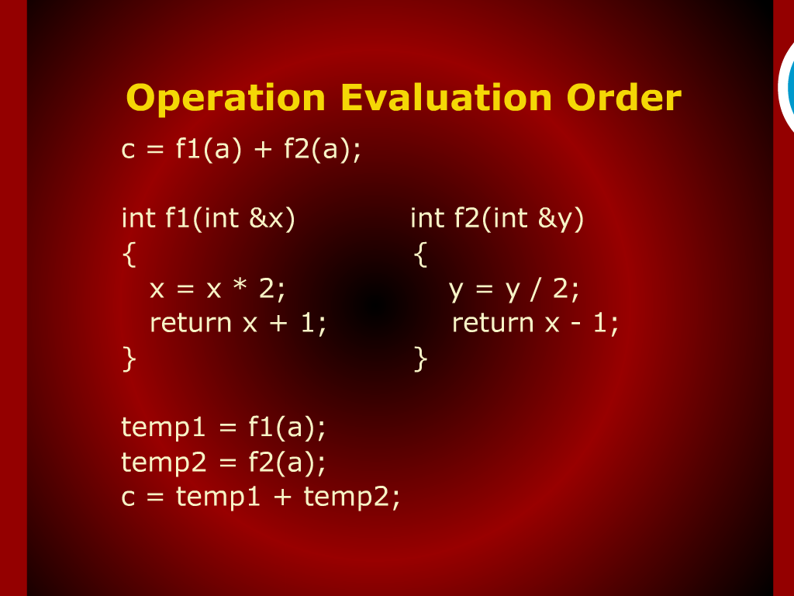
Operation Evaluation Order

Slide 3
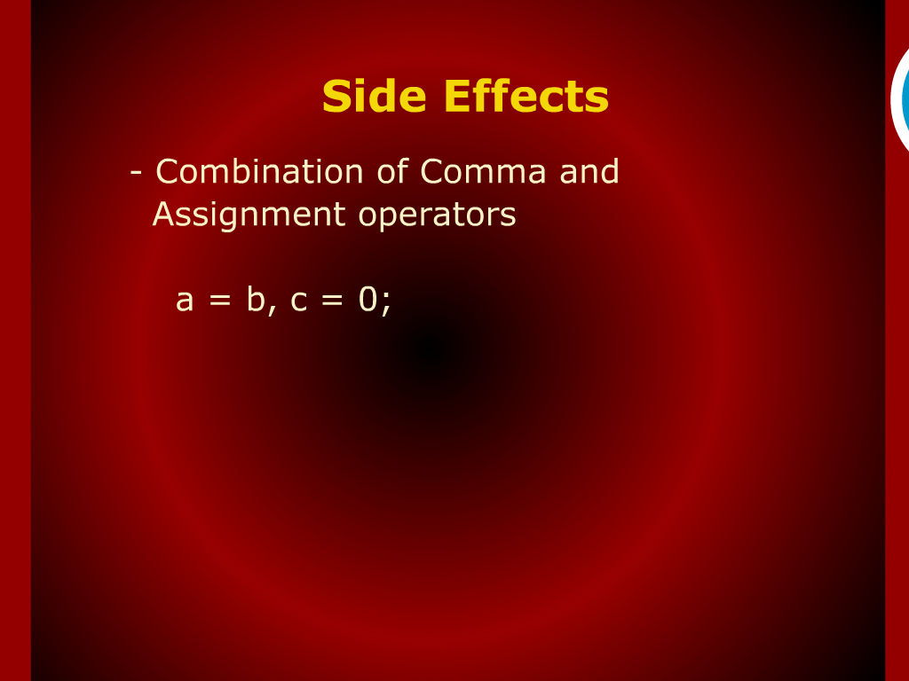
Side Effects

Slide 4
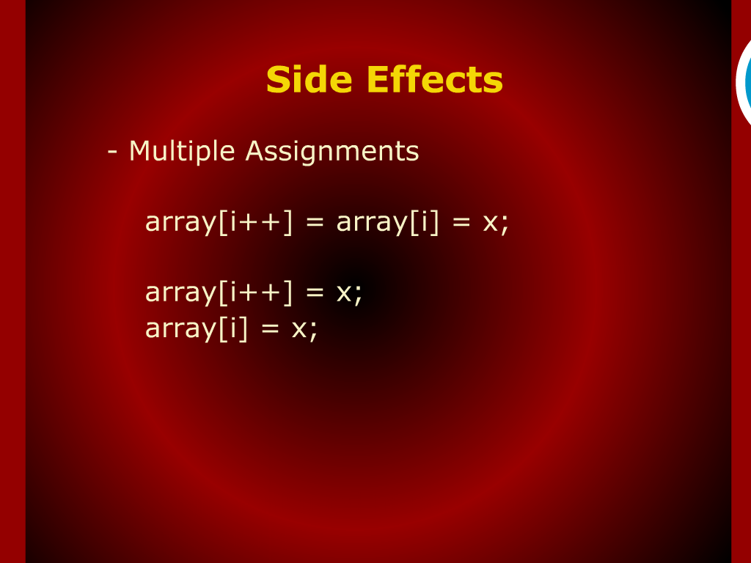
Side Effects

Slide 5
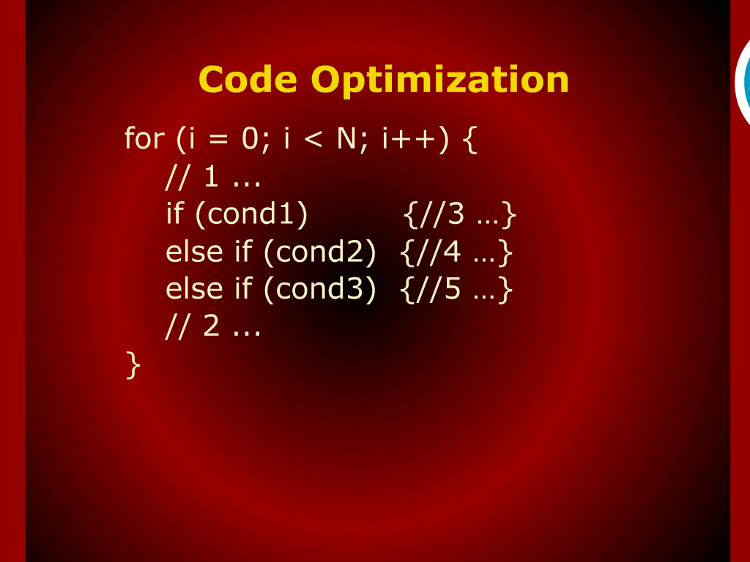
Code Optimization

Slide 6
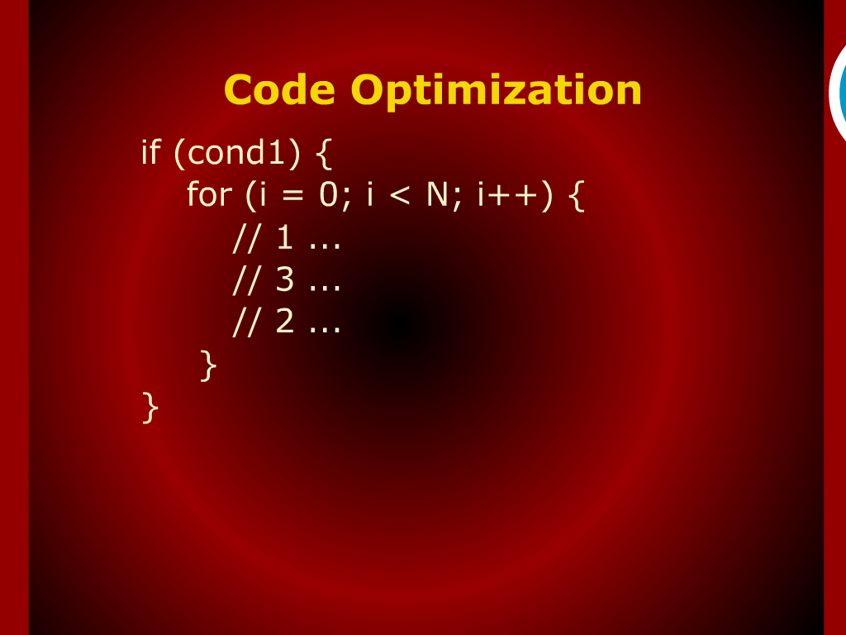
Code Optimization

Slide 7
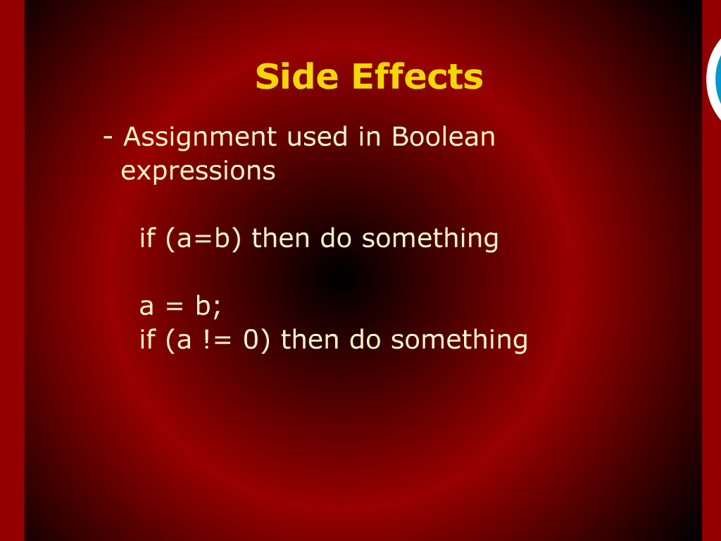
Side Effects

Slide 8
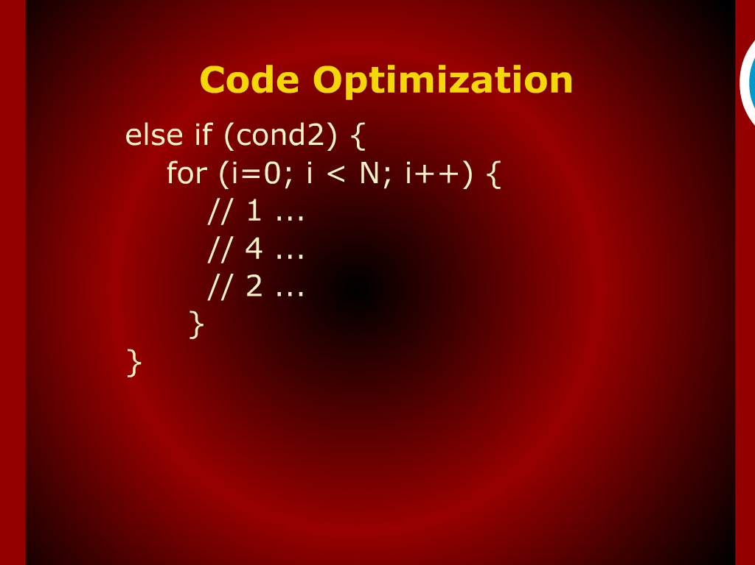
Code Optimization

Slide 9
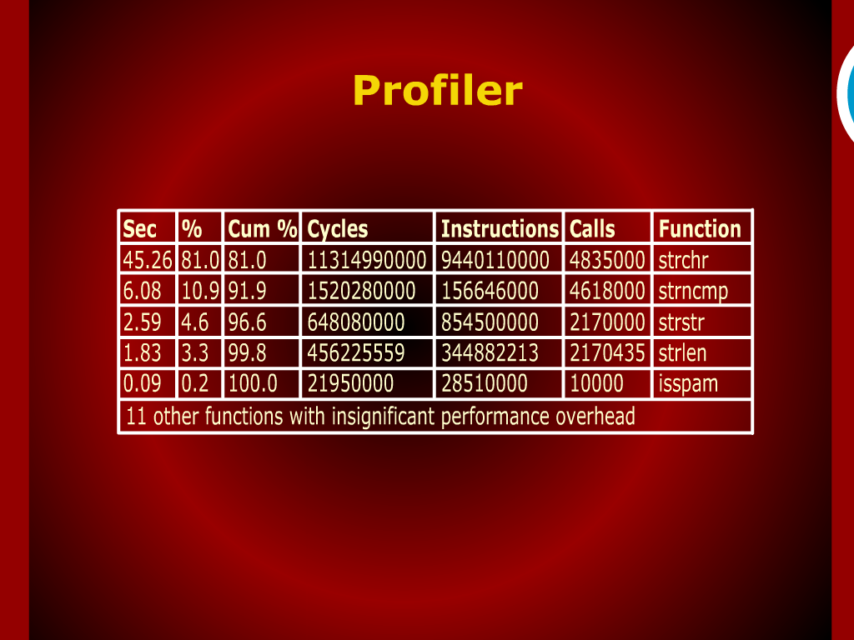
Profiler

Slide 10
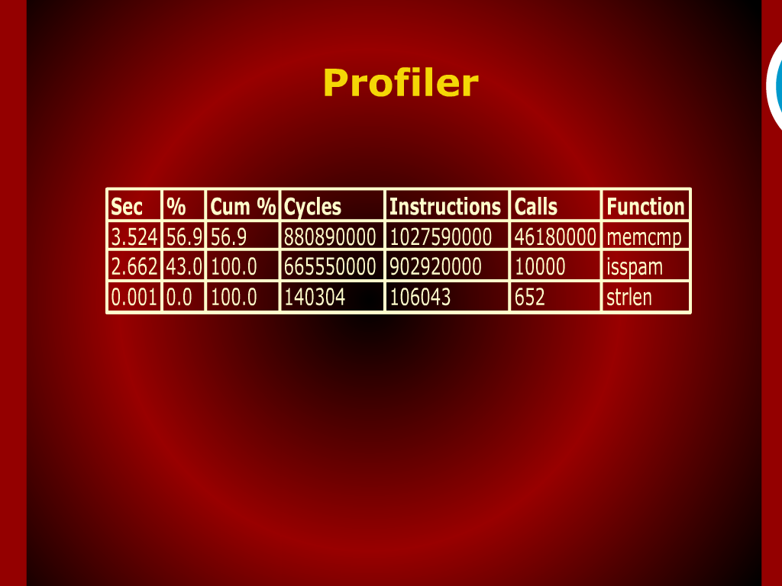
Profiler

Slide 11
Profiling and Performance Tuning

Slide 12
Performance

Slide 13
Operand Evaluation Order and Side Effects

Slide 14
Writing Maintenance Code

Slide 15
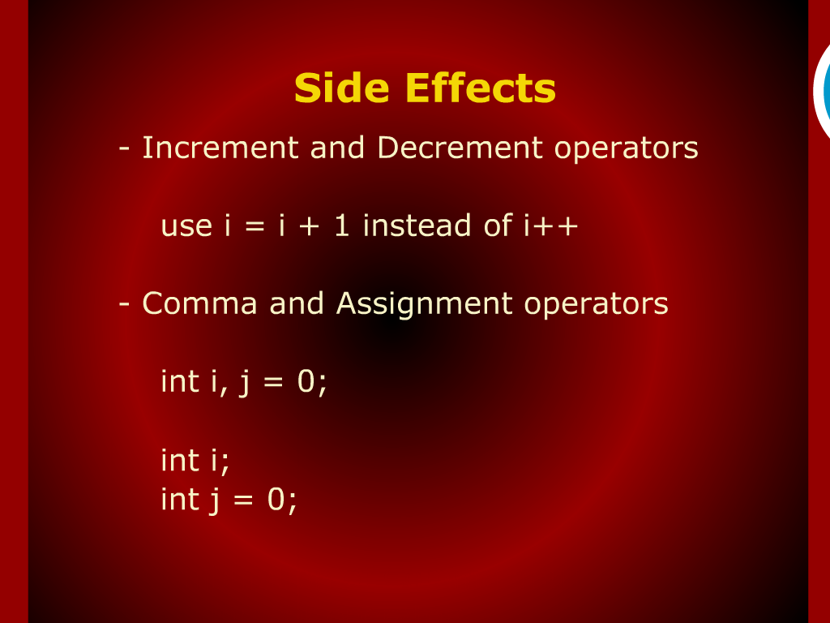
Side Effects

